Slide 1

The Nodal Count Distribution of Quantum Graphs
Lior Alon
Technion, Israel
Based on joint work with
Ram Band (Technion)
Gregory Berkolaiko (Texas A&M university)

Slide 2

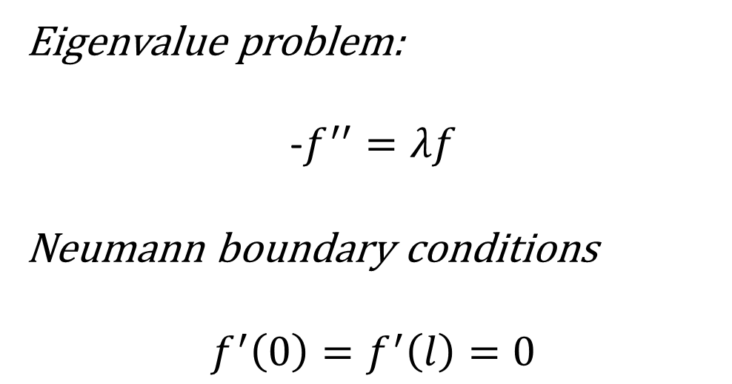
The Laplacian on the segment $[0,l]$
Eigenvalue problem:
-$f^{′′}=λf$
Neumann boundary conditions
$$f^{′}\left(0\right)=f^{′}\left(l\right)=0$$

Slide 3
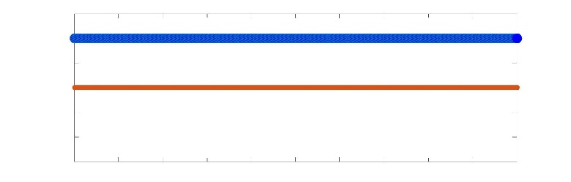
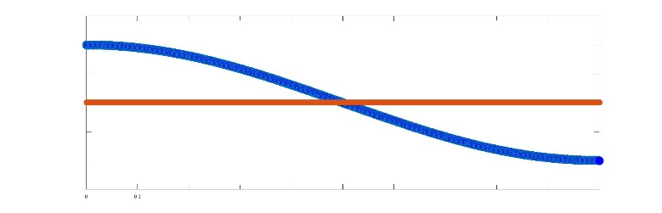
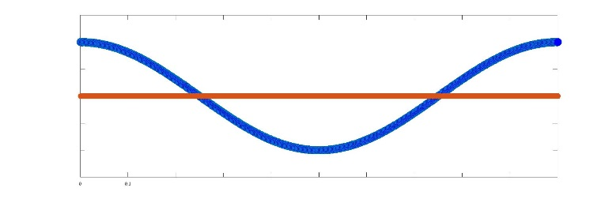




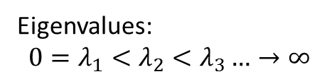


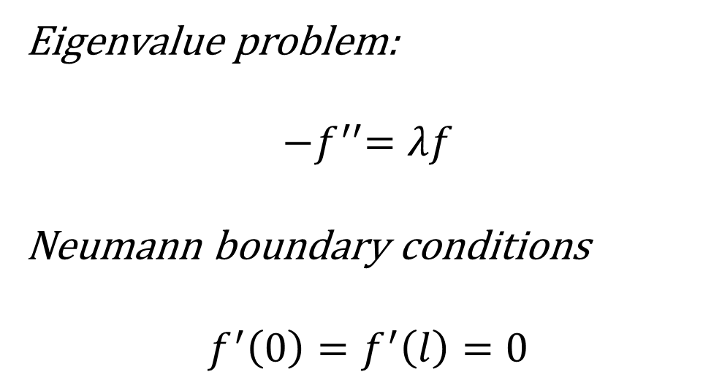


The Laplacian on the segment $[0,l]$
Eigenvalue problem:
$${−f}^{′′}=λf$$
Neumann boundary conditions
$$f^{′}\left(0\right)=f^{′}\left(l\right)=0$$
Eigenvalues:
$${0=λ}_{1}<λ_{2}<λ_{3}…→∞$$
Eigenfunctions:
$$f_{1}$$
$$0$$
$$l$$
$$f_{2}$$
$$0$$
$$l$$
$$f_{3}$$
$$0$$
$$l$$

Slide 4
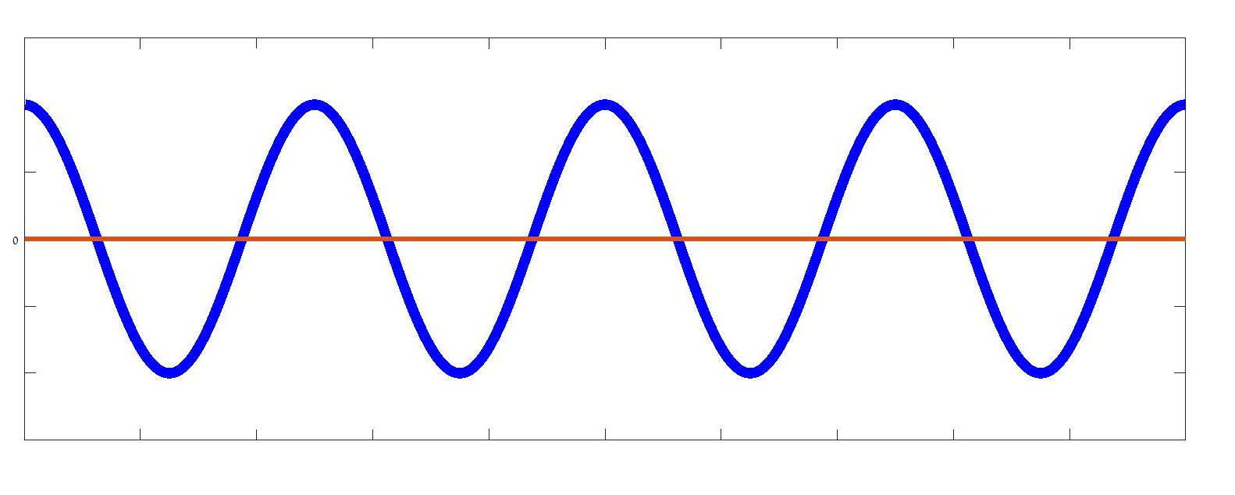


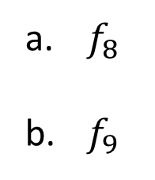


Can you identify the eigenfunction?
$$f_{n}$$
$$0$$
$$l$$
Is it:
$f_{8}$
$f_{9}$
$f_{10}$
$f_{20}$

Slide 5
Can you identify the eigenfunction?
$$f_{n}$$
$$0$$
$$l$$
Is it:
$f_{8}$
$f_{9}$
$f_{10}$
$f_{20}$

Slide 6
Can you identify the eigenfunction?
$$f_{n}$$
$$0$$
$$l$$
Is it:
$f_{8}$
$f_{9}$
$f_{10}$
$f_{20}$

Slide 7



Can you identify the eigenfunction?
$$f_{9}$$
Nodal points
$$0$$
$$l$$
$$φ_{n}=\#\{nodal points\}$$
$$φ_{n}=8$$

Slide 8

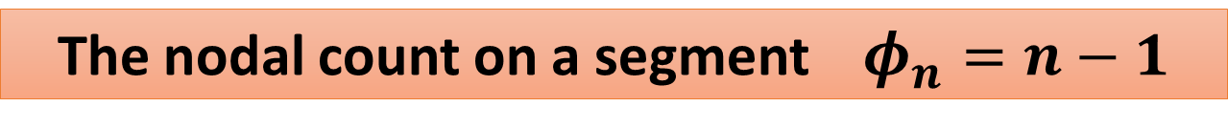
Can you identify the eigenfunction?
$$f_{9}$$
$$0$$
$$l$$
The nodal count on a segment $φ_{n}=n−1$
Sturm – 1836’
$$φ_{n}=8 ⇒ n=9$$

Slide 9



The Laplacian on a graph
The “Dumbbell Graph”
$$e_{1}$$
$$e_{3}$$
$$e_{2}$$

Slide 10
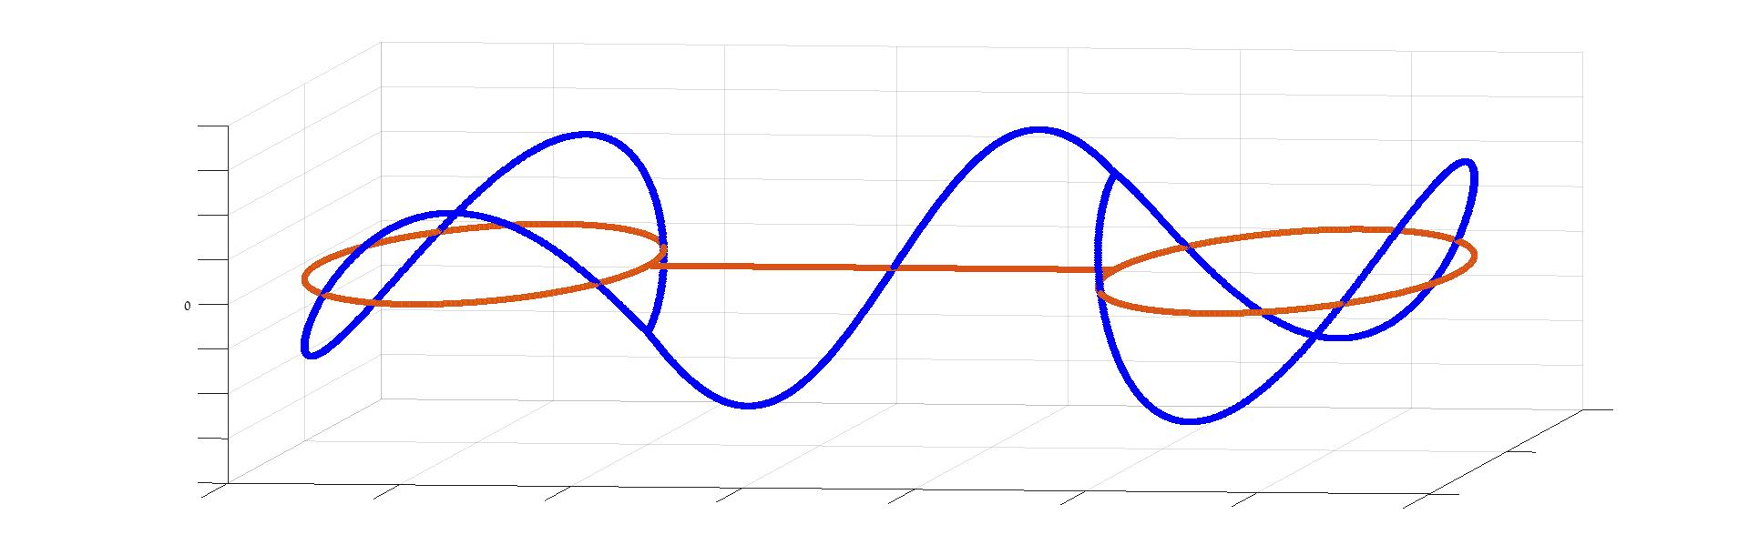
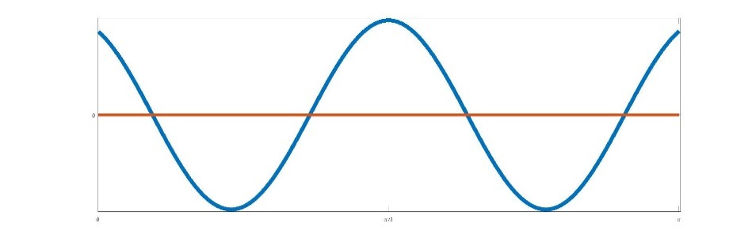
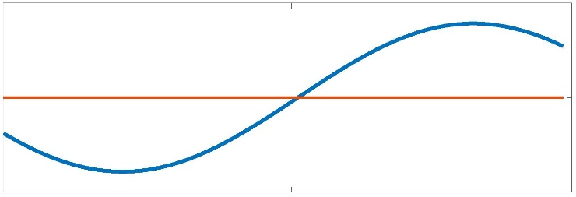
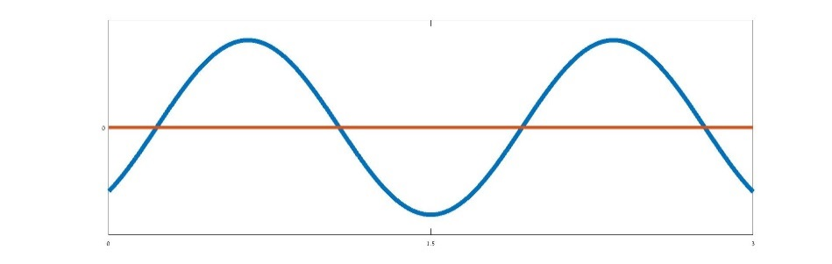












The Laplacian on a graph
$$e_{1}$$
$$e_{3}$$
$$e_{2}$$
$$f$$
$${f|}_{e_{1}}$$
$${f|}_{e_{2}}$$
$${f|}_{e_{3}}$$
$$0$$
$$l_{1}$$
$$0$$
$$l_{2}$$
$$0$$
$$l_{3}$$

Slide 11
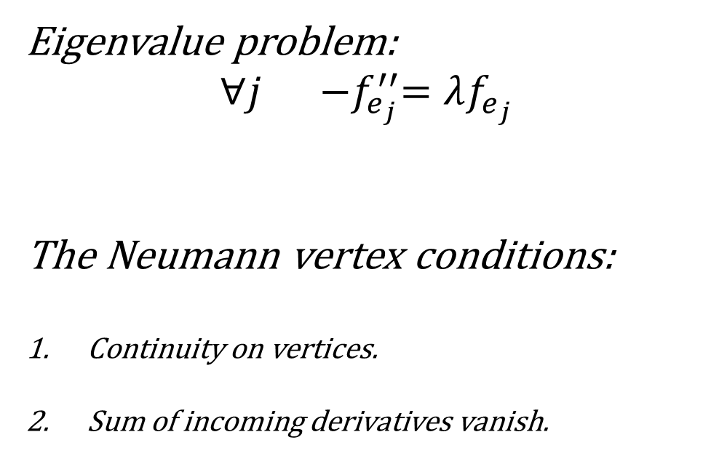
The Laplacian on a graph
Eigenvalue problem:
$$∀j {−f}_{e_{j}}^{′′}=λf_{e_{j}}$$
The Neumann vertex conditions:
Continuity on vertices.
Sum of incoming derivatives vanish.

Slide 12
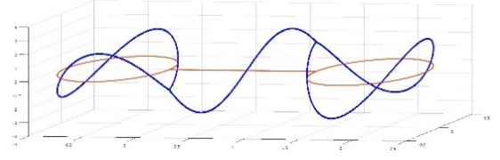
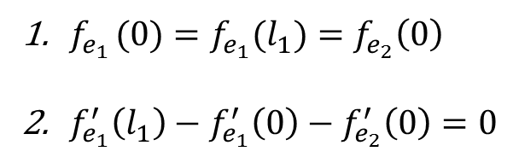
The Laplacian on a graph
Eigenvalue problem:
$$∀j {−f}_{e_{j}}^{′′}=λf_{e_{j}}$$
The Neumann vertex conditions:
Continuity on vertices.
Sum of incoming derivatives vanish.
$f_{e_{1 }}(0)=f_{e_{1}}(l_{1})=f_{e_{2}}\left(0\right)$
$f_{e_{1}}^{′}\left(l_{1}\right)−f_{e_{1}}^{′}\left(0\right)−f_{e_{2}}^{′}\left(0\right)=0$

Slide 13
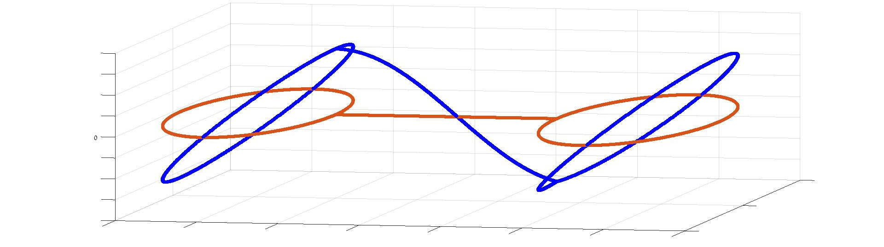
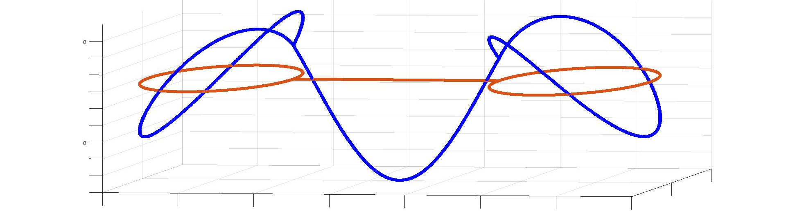
Can you identify the eigenfunctions?

Slide 14
Can you identify the eigenfunctions?

Slide 15


Can you identify the eigenfunctions?
$$f_{6}$$
$$φ_{6}=5$$

Slide 16


Can you identify the eigenfunctions?
$$f_{6}$$
$$φ_{6}=5$$
$$f_{7}$$
$$φ_{7}=6$$

Slide 17


Can you identify the eigenfunctions?
$$f_{6}$$
$$φ_{6}=5$$
$$f_{7}$$
$$φ_{7}=6$$
$$f_{8}$$
$$φ_{8}=9$$

Slide 18
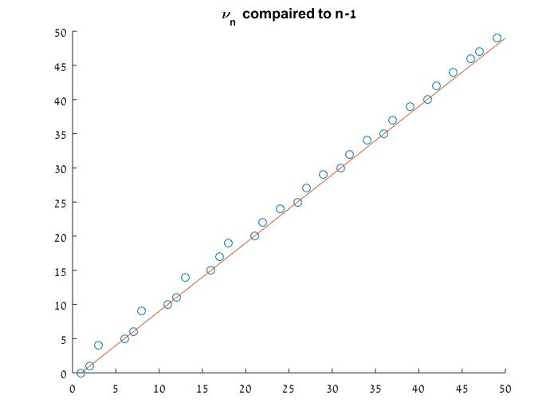


The nodal count of a quantum graph
compared to a segment
$$φ_{n}$$
Dumbbell graph
n - 1
$$n$$

Slide 19

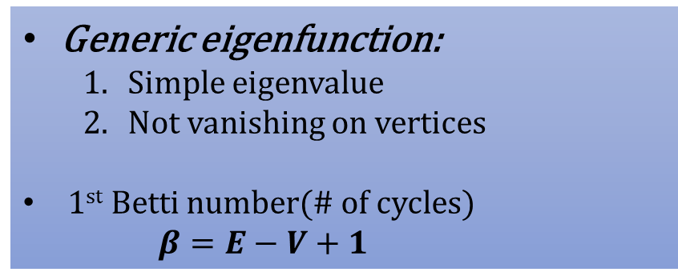

The nodal count on a quantum graph
Generic eigenfunction:
Simple eigenvalue
Not vanishing on vertices
1st Betti number(# of cycles)
$β=E−V+1$
$$φ_{n}$$
$$n$$

Slide 20


The nodal count on a quantum graph
Generic eigenfunction:
Simple eigenvalue
Not vanishing on vertices
1st Betti number(# of cycles)
$β=E−V+1$
$$φ_{n}$$
The dumbbell graph has $β=2$
A tree graph has $β=0$
$$n$$

Slide 21
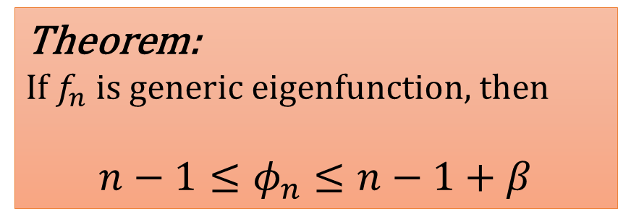
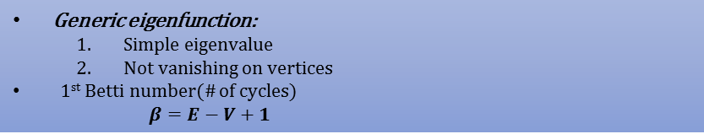
The nodal count on a quantum graph
Generic eigenfunction:
Simple eigenvalue
Not vanishing on vertices
1st Betti number(# of cycles)
$β=E−V+1$
$$φ_{n}$$
Theorem:
If $f_{n}$ is generic eigenfunction, then
$${n−1≤φ}_{n}≤n−1+β$$
Courant – 23’
Gnutzmann, Smilansky, Webber - 03’
Al-Obeid, Pokornyi, Pryadiev-’96
Schapotschnikow-’06.
Berkolaiko – 07’
$$n$$

Slide 22
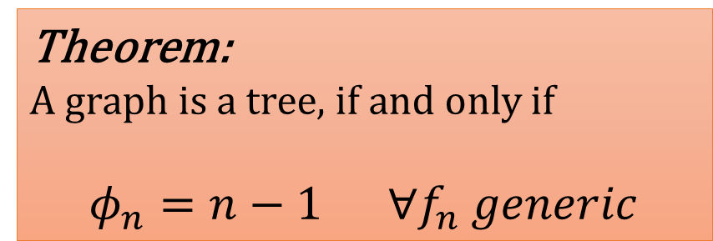
The nodal count on a quantum graph
Generic eigenfunction:
Simple eigenvalue
Not vanishing on vertices
1st Betti number(# of cycles)
$β=E−V+1$
Theorem:
If $f_{n}$ is generic eigenfunction, then
$${n−1≤φ}_{n}≤n−1+β$$
Theorem:
A graph is a tree, if and only if
$φ_{n}=n−1 ∀f_{n} generic$
Courant – 23’
Gnutzmann, Smilansky, Webber - 03’
Al-Obeid, Pokornyi, Pryadiev-’96
Schapotschnikow-’06.
Berkolaiko – 07’
Band – 14’

Slide 23
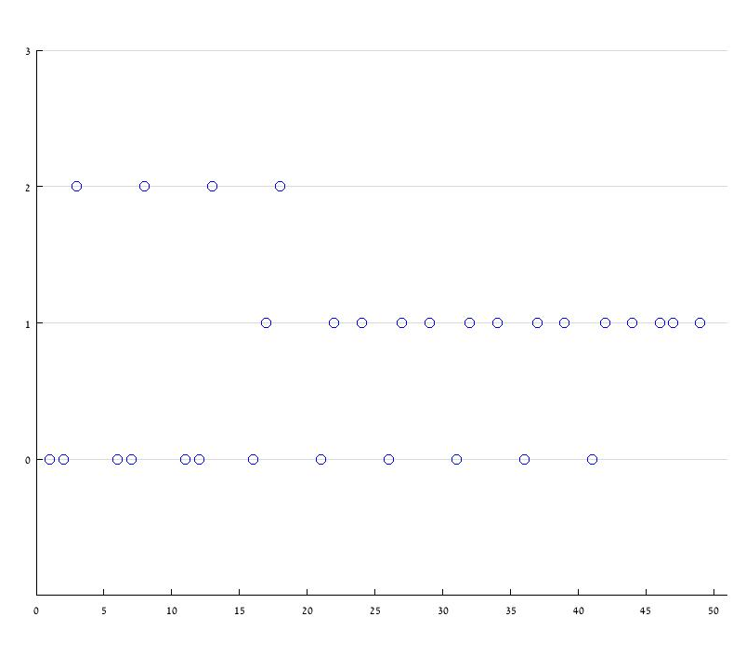



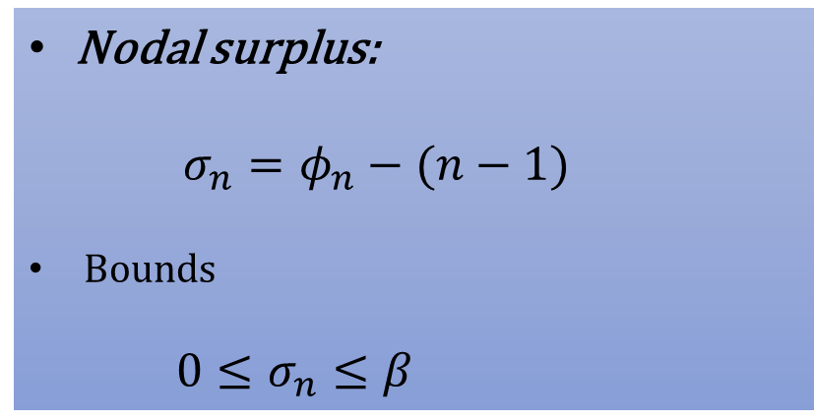


The nodal surplus
Nodal surplus:
$$σ_{n}=φ_{n}−(n−1)$$
Bounds
${0≤σ}_{n}≤β$
$$σ_{n}$$
$$β=2$$
$$1$$
$$0$$
Dumbbell graph
$$n$$

Slide 24
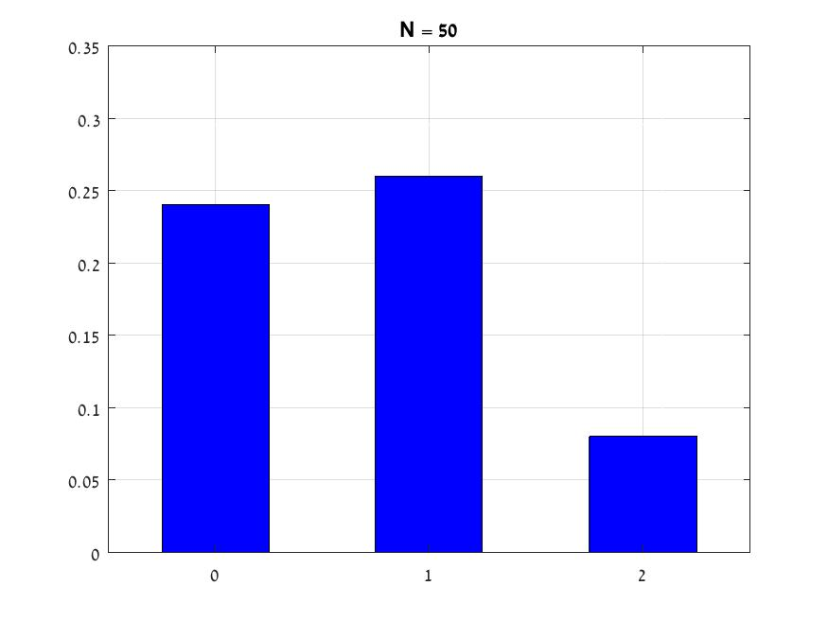
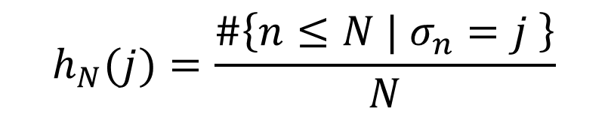


Histogram of the nodal surplus
Nodal surplus:
$$σ_{n}=φ_{n}−(n−1)$$
Bounds
${0≤σ}_{n}≤β$
$$h_{N}$$
$$h_{N}(j)=\frac{\#\left\{n≤N | σ_{n}=j \right\}}{N}$$
$$j$$

Slide 25

Histogram of the nodal surplus
Nodal surplus:
$$σ_{n}=φ_{n}−(n−1)$$
Bounds
${0≤σ}_{n}≤β$
$$h_{N}$$
$$h_{N}(j)=\frac{\#\left\{n≤N | σ_{n}=j \right\}}{N}$$
$$j$$

Slide 26
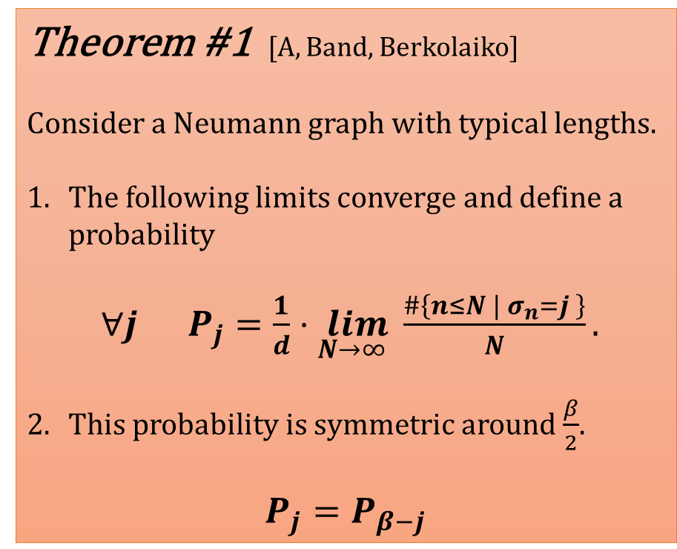
Main results
Theorem #1 [A, Band, Berkolaiko]
Consider a Neumann graph with typical lengths.
The following limits converge and define a probability
$∀j P_{j}=\frac{1}{d}⋅\lim_{N→∞ }{\frac{\#\left\{n≤N | σ_{n}=j \right\}}{N}}.$
This probability is symmetric around $\frac{β}{2}$.
$P_{j}=P_{β−j}$

Slide 27
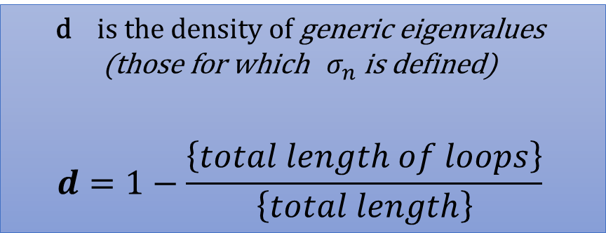
Main results
Theorem #1 [A, Band, Berkolaiko]
Consider a Neumann graph with typical lengths.
The following limits converge and define a probability
$∀j P_{j}=\frac{1}{d}⋅\lim_{N→∞ }{\frac{\#\left\{n≤N | σ_{n}=j \right\}}{N}}.$
This probability is symmetric around $\frac{β}{2}$.
$P_{j}=P_{β−j}$
d is the density of generic eigenvalues
(those for which $σ_{n}$ is defined)
$$d=1−\frac{\left\{total length of loops\right\}}{\left\{total length\right\}}$$

Slide 28
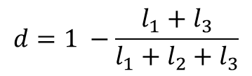
Main results
Theorem #1 [A, Band, Berkolaiko]
Consider a Neumann graph with typical lengths.
The following limits converge and define a probability
$∀j P_{j}=\frac{1}{d}⋅\lim_{N→∞ }{\frac{\#\left\{n≤N | σ_{n}=j \right\}}{N}}.$
This probability is symmetric around $\frac{β}{2}$.
$P_{j}=P_{β−j}$
d is the density of generic eigenvalues
(those for which $σ_{n}$ is defined)
$$d=1−\frac{\left\{total length of loops\right\}}{\left\{total length\right\}}$$
$$e_{1}$$
$$e_{3}$$
$$e_{2}$$
$$d=1 −\frac{l_{1}+l_{3}}{l_{1}+l_{2}+l_{3}}$$

Slide 29
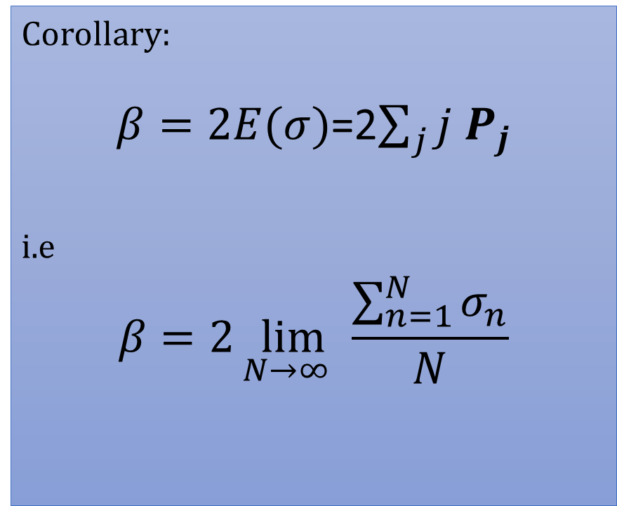
Main results
Theorem #1 [A, Band, Berkolaiko]
Consider a Neumann graph with typical lengths.
The following limits converge and define a probability
$∀j P_{j}=\frac{1}{d}⋅\lim_{N→∞ }{\frac{\#\left\{n≤N | σ_{n}=j \right\}}{N}}.$
This probability is symmetric around $\frac{β}{2}$.
$P_{j}=P_{β−j}$
Corollary:
$β=2E(σ)$=2$\sum_{j}{j P_{j}}$
i.e
$$β=2\lim_{N→∞ }{\frac{\sum_{n=1}^{N}{σ_{n}}}{N}}$$

Slide 30
Main results
Tree of cycles (TOC):
We say that a graph is a Tree of cycles if we can construct it by taking a tree and replace some of its vertices by cycles.

Slide 31
Main results
Tree of cycles (TOC):
We say that a graph is a Tree of cycles if we can construct it by taking a tree and replace some of its vertices by cycles.
TOC graphs

Slide 32
Main results
Tree of cycles (TOC):
We say that a graph is a Tree of cycles if we can construct it by taking a tree and replace some of its vertices by cycles.
TOC graphs
Non TOC graphs

Slide 33
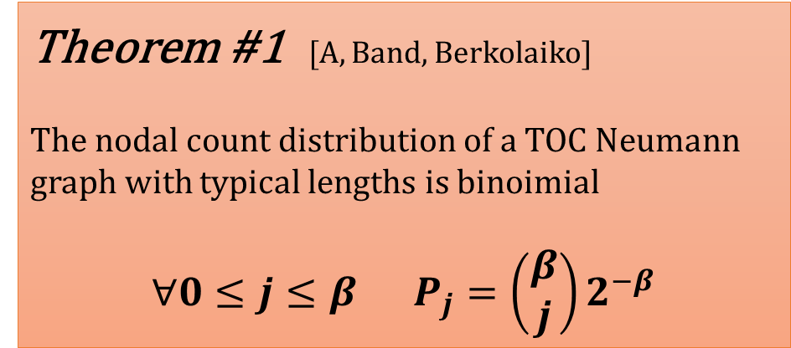
Main results
TOC:
taking a tree and replace some of its vertices by cycles.
Theorem #1 [A, Band, Berkolaiko]
The nodal count distribution of a TOC Neumann graph with typical lengths is binoimial
$∀0≤j≤β P_{j}=\left(\begin{matrix}β \\ j\end{matrix}\right)2^{−β}$

Slide 34
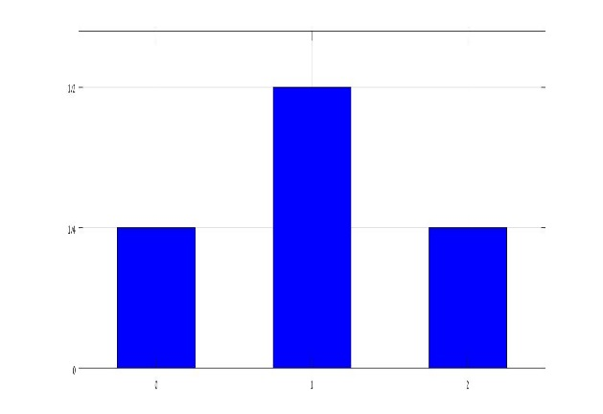




$β=2$ examples
$$P(σ=j)$$
TOC:
taking a tree and replace some of its vertices by cycles.
TOC graph
$\frac{1}{2}$
$\frac{1}{4}$
Theorem #1 [A, Band, Berkolaiko]
The nodal count distribution of a TOC Neumann graph with typical lengths is binoimial
$∀0≤j≤β P_{j}=\left(\begin{matrix}β \\ j\end{matrix}\right)2^{−β}$
0
1
2

Slide 35
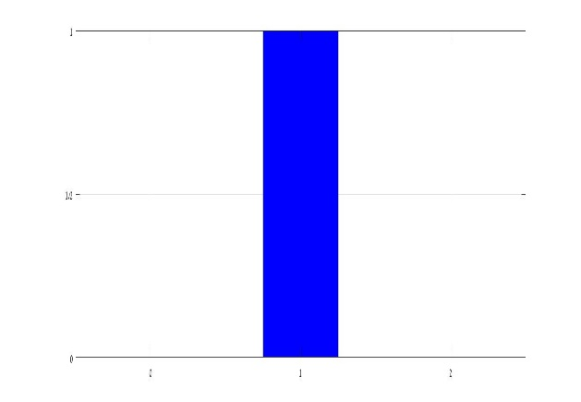


$β=2$ examples
$$P(σ=j)$$
TOC:
taking a tree and replace some of its vertices by cycles.
TOC graph
$\frac{1}{2}$
$\frac{1}{4}$
Theorem #1 [A, Band, Berkolaiko]
The nodal count distribution of a TOC Neumann graph with typical lengths is binoimial
$∀0≤j≤β P_{j}=\left(\begin{matrix}β \\ j\end{matrix}\right)2^{−β}$
0
1
2
$$P(σ=j)$$
$$1$$
Non TOC graph
$\frac{1}{2}$
0
1
2

Slide 36
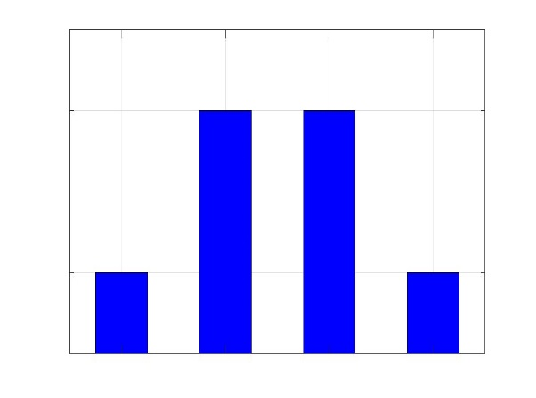



$β=3$ examples
$$P(σ=j)$$
TOC:
taking a tree and replace some of its vertices by cycles.
TOC graph
$\frac{3}{8}$
Theorem #1 [A, Band, Berkolaiko]
The nodal count distribution of a TOC Neumann graph with typical lengths is binoimial
$∀0≤j≤β P_{j}=\left(\begin{matrix}β \\ j\end{matrix}\right)2^{−β}$
$\frac{1}{8}$
0
1
2
3

Slide 37
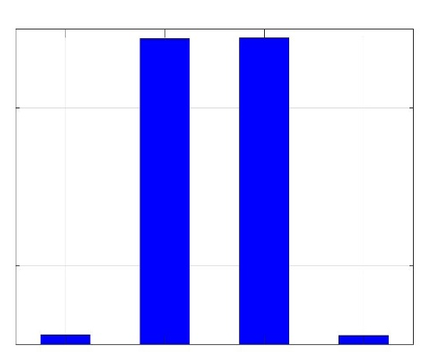
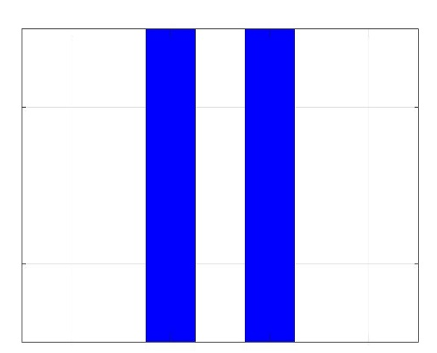


$β=3$ examples
$$P(σ=j)$$
TOC:
taking a tree and replace some of its vertices by cycles.
TOC graph
$\frac{3}{8}$
Theorem #1 [A, Band, Berkolaiko]
The nodal count distribution of a TOC Neumann graph with typical lengths is binoimial
$∀0≤j≤β P_{j}=\left(\begin{matrix}β \\ j\end{matrix}\right)2^{−β}$
$\frac{1}{8}$
0
1
2
3
Non TOC graphs
$$P(σ=j)$$
$$P(σ=j)$$
$\frac{3}{8}$
$\frac{3}{8}$
$\frac{1}{8}$
$\frac{1}{8}$
0
1
2
3
0
1
2
3

Slide 38
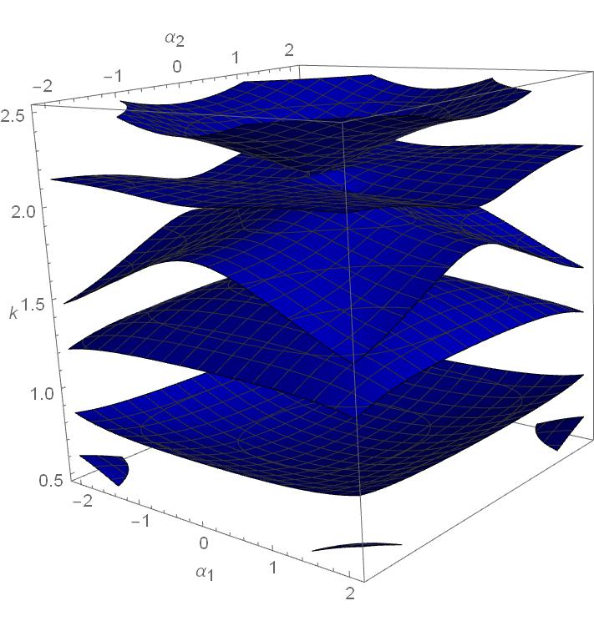



Main tools (and some nice mathematics)
The nodal magnetic connection [Berkolaiko, Weyand – 14’]
$$k$$
$$α_{2}$$
$$α_{1}$$

Slide 39




Main tools (and some nice mathematics)
The nodal magnetic connection[Berkolaiko, Weyand – 14’]
A quantum graph as a scattering system [Kottos, Smilansky 97’]
$$k$$
$$α_{1}$$
$$α_{2}$$

Slide 40
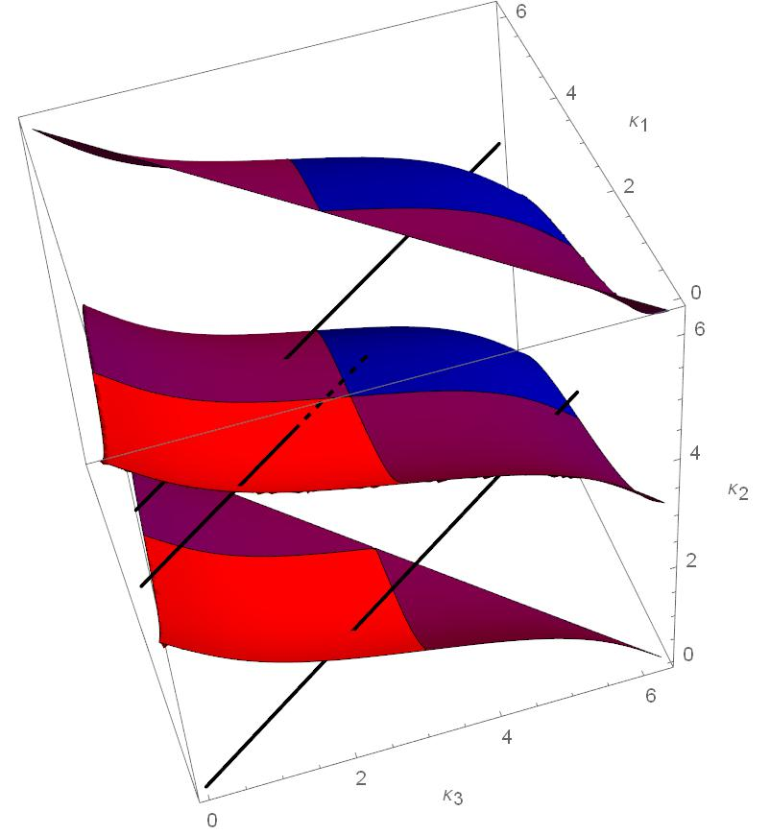



Main tools (and some nice mathematics)
The nodal magnetic connection [Berkolaiko, Weyand – 14’]
A quantum graph as a scattering system [Kottos, Smilansky 97’]
Ergodicity [Barra, Gaspard – 00’]
$$k$$
$$α_{1}$$
$$α_{2}$$
$$θ_{3}$$
$$θ_{2}$$
$$θ_{1}$$

Slide 41
What’s next?
Edge lengths dependence

Slide 42
What’s next?
Edge lengths dependence
Vertex separated graphs

Slide 43
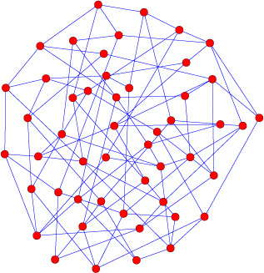
What’s next?
Edge lengths dependence
Vertex separated graphs
Highly connected random graphs

Slide 44
What’s next?
Edge lengths dependence
Vertex separated graphs
Highly connected random graphs
Conjecture:
The relative entropy of a k-regular random graphs with typical lengths depends only on k

Slide 45


Slide 46
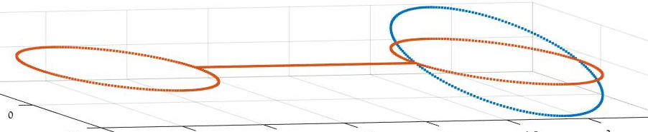
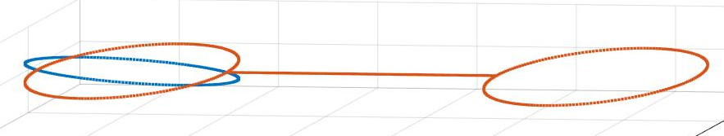
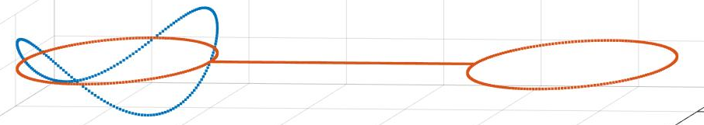





“Bad eigenfunctions”
$$f_{4}$$
$$φ_{n}$$
$φ_{n}$ compared to $n−1$
$$f_{5}$$
$$f_{10}$$

